Slide 1
Classes of Languages
CMSC 330: Programming Languages

Slide 2
Common Classes of Languages
Imperative
Functional
Object-oriented
Logic

Slide 3
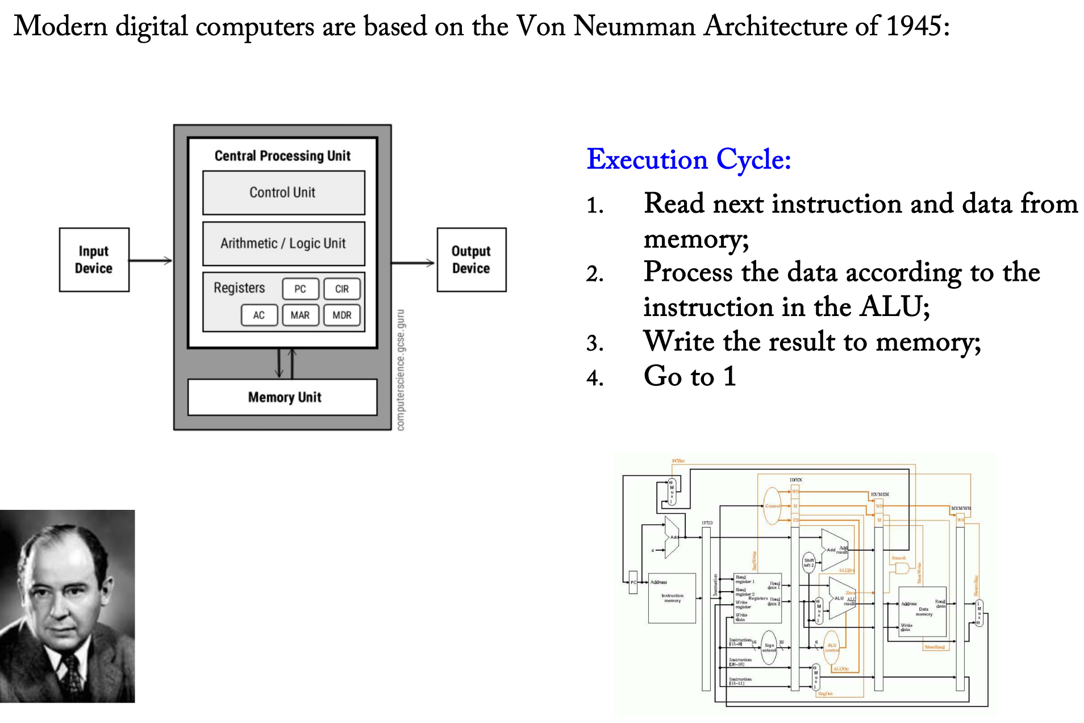
Von Neumman Model

Slide 4
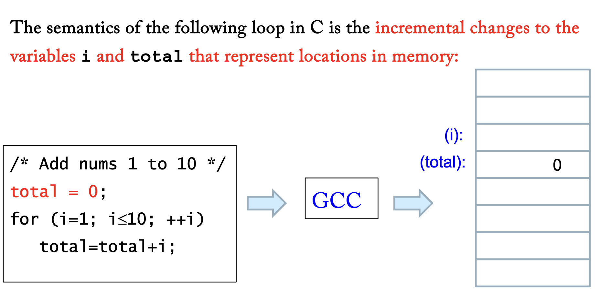
Imperative Languages
An imperative language sticks close to this model, and the semantics is all about what happens in the memory. It therefore emphasizes statements which have an effect on memory.

Slide 5
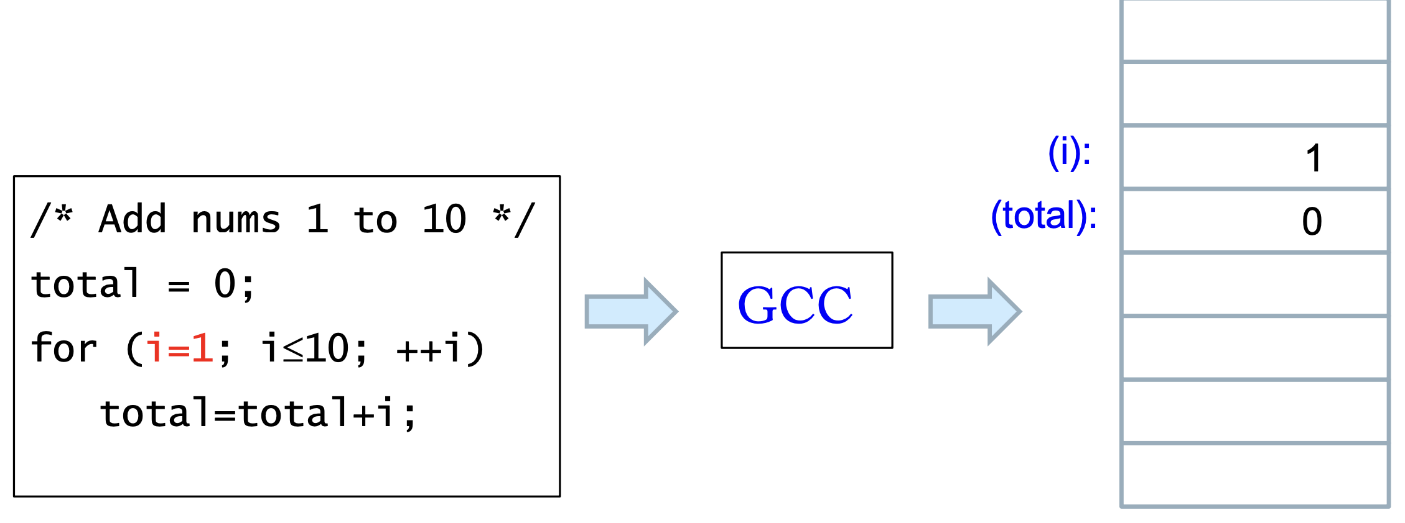
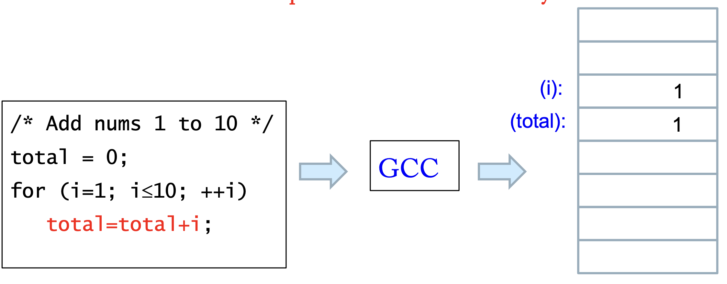
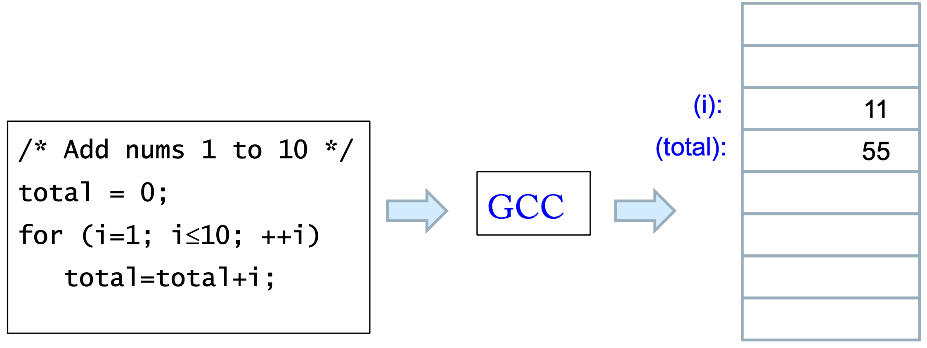

Slide 6



Imperative Languages
In programming language theory (and in this course), the memory, as a whole, in whatever form and technology it involves, is called the state, so just remember:
State = All the data stored in memory
Therefore, the meaning of an imperative language is the sequence of state transitions that the statements in the language produce. Such a process is therefore called stateful.

Slide 7
What is Wrong with the Imperative Paradigm?
Memory is complicated (registers, status bits, caches, RAM, run-time stack, …) and does not always correspond in a natural way to program structure.
Mentally keeping track of dozens or 100’s of variables is difficult.
Debuggers (Eclipse, GDB) help, but are very complicated (many people just use print statements to print out all relevant variables)

Slide 8
Functional Languages
What is the essence of mathematical reasoning?
For example, in the case of ordinary algebra:
(3 + 4) * (5 - 2) = 7 * (5 - 2) = 7 * 3 = 21
No variables keeping track of the state.
The computation rewrite one term to another using basic definitions of +, -, and *.

Slide 9
Functional Languages
Functional programming is a style of programming in which the fundamental method of computation is applying a function to arguments; a functional programming language is one that supports and encourages the functional style.
Functional programming avoids mutable state: variables are immutable bindings rather than changeable memory locations, and new data structures are created instead of updated. Memory is implicit—the programmer manipulates values rather than memory locations. Pure functional code is referentially transparent: expressions can be replaced by their results without changing program behavior

Slide 10
Referential Transparency
A function is referentially transparent if a call can be replaced by its value without changing program behavior.
Output depends only on input.
No side effects (no modifying global variables, no hidden state, no I/O).
Same input → always same output.

Slide 11
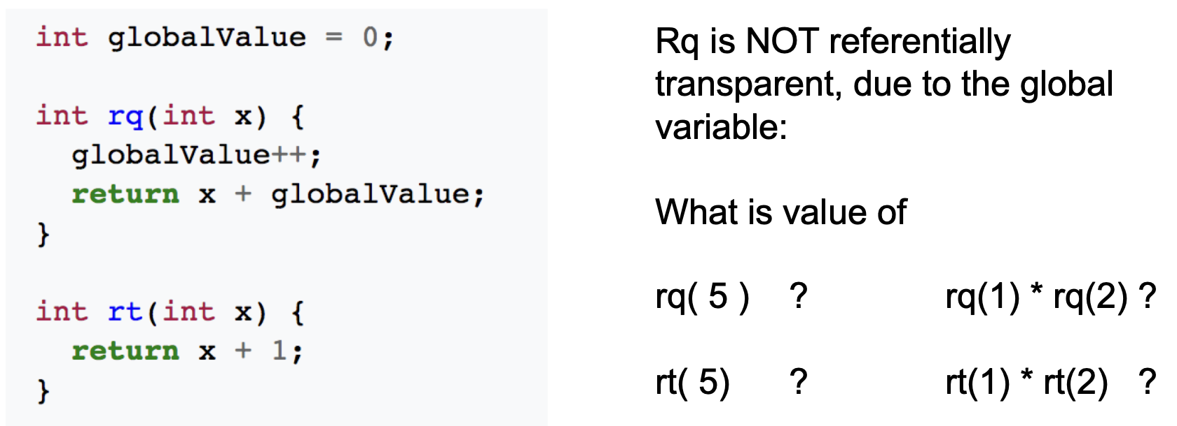
Referential Transparency
More predictable and easier to reason about.
Easier debugging and testing.
Enables compiler optimization and safe parallel execution.

Slide 12
Ways to Compare Languages
Imperative vs. Declarative
Structured vs. Non-structured
Compiled vs. Interpreted vs. Hybrid

Slide 13
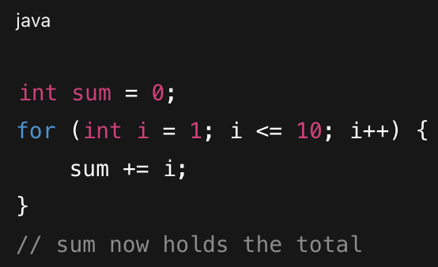
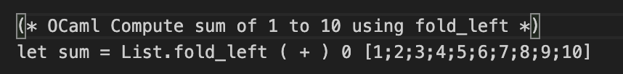
Imperative vs. Declarative
A declarative language lets you state what you want, without specifying the exact sequence of steps to achieve it.
E.g., JavaScript DOM (imperative) vs React.js (declarative)
E.g.,

Slide 14
Structured vs. Unstructured
Structured Languages use three control flow mechanisms
1. Sequence (successive statements)
2. Selection (e.g., if/else or switch)
3. Repetition (e.g., for loops, while loops)
Any computable function can be computed with only these three mechanisms

Slide 15
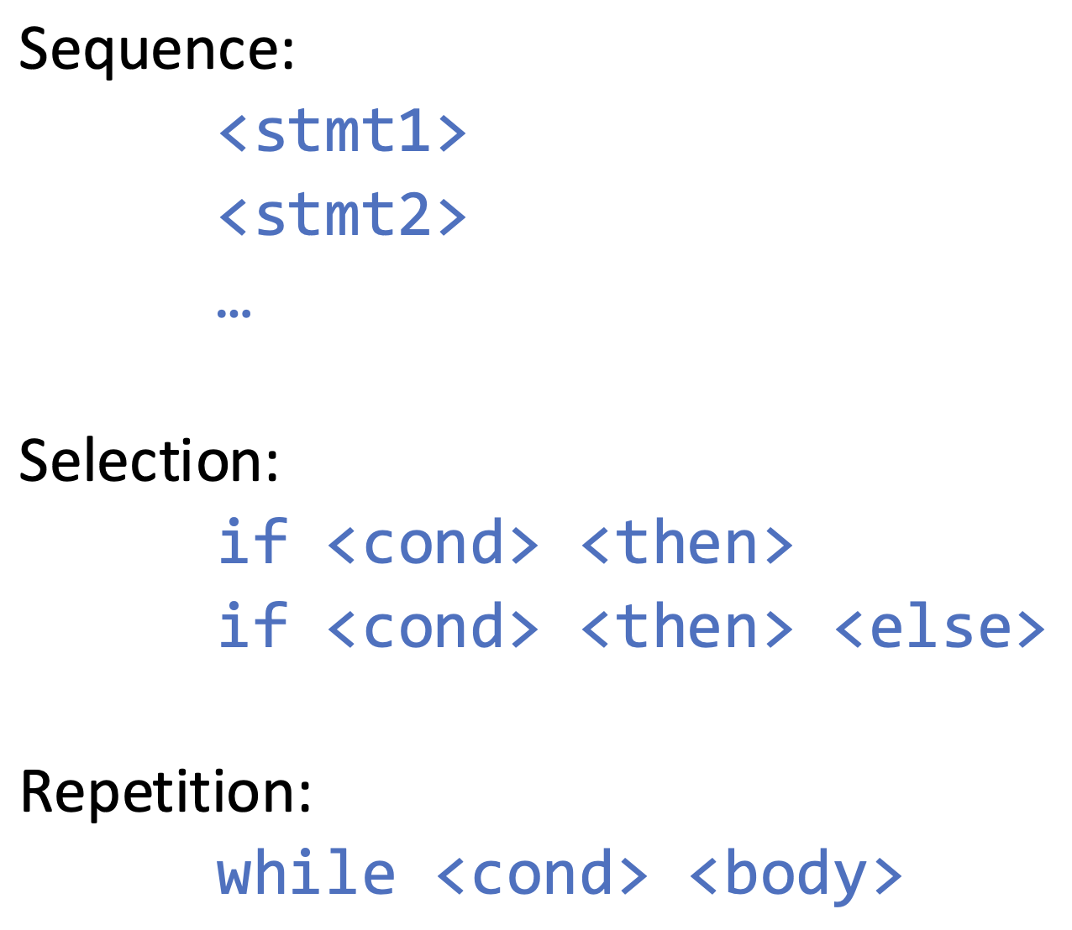
Structured Languages

Slide 16
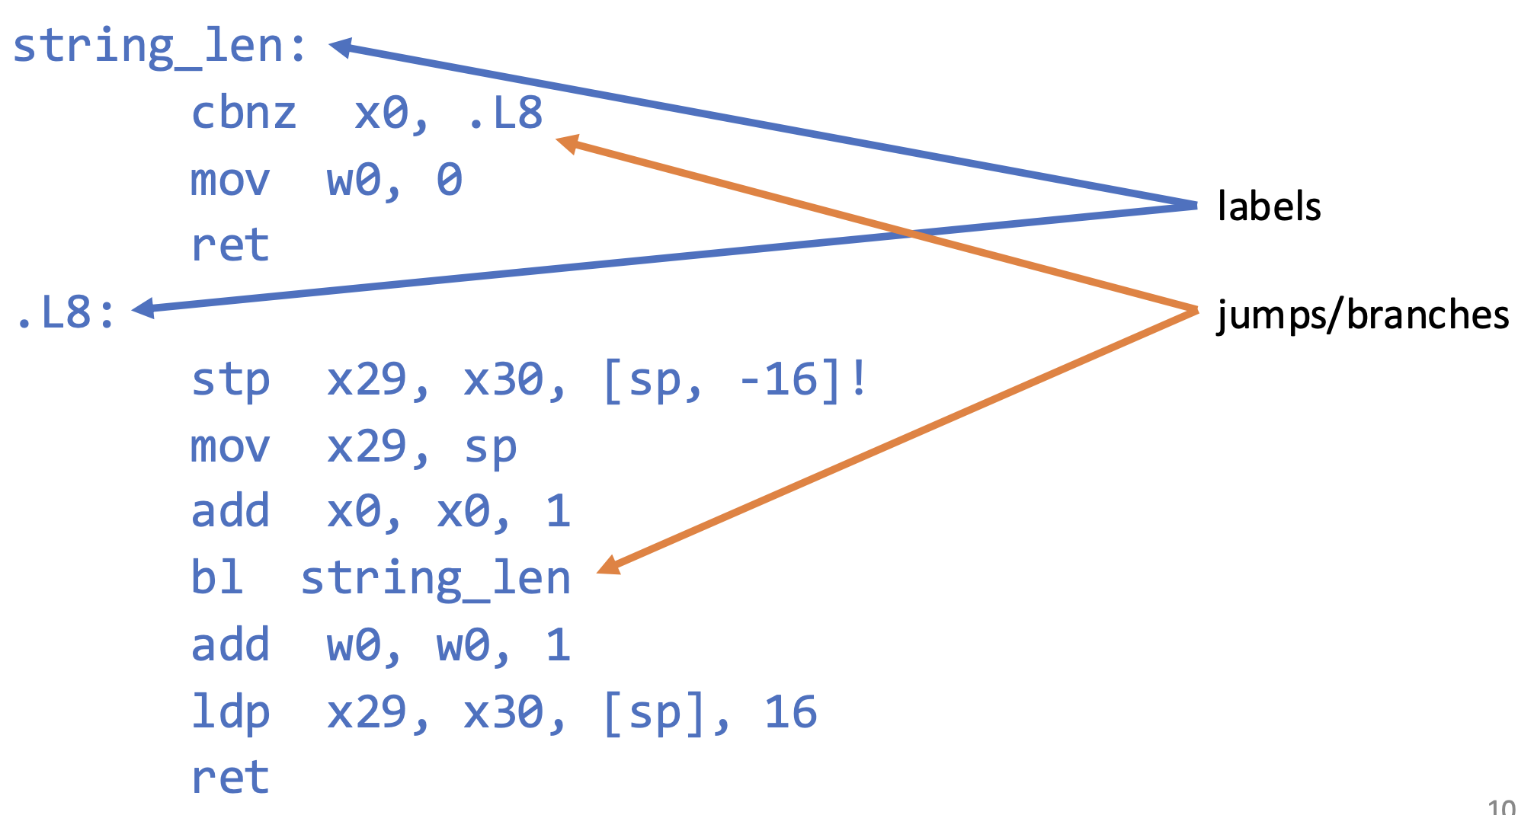
Unstructured Languages

Slide 17
Questions
What languages are structured?
What languages are unstructured?
Why would you want to program in an unstructured language?
Maximum control and efficiency (direct access to CPU instructions and registers)
Hardware-level manipulation
Use very little resources

Slide 18
Compiled vs. Interpreted vs. Hybrid
Language Implementation Methods
Ahead-Of-Time (AOT) Compilation
Entire program translated from source to target before being run.
Target language is at lower level of abstraction.
Just-In-Time (JIT) Compilation
Compiles Intermediate Representation (IR) to machine code at runtime

Slide 19
Compiled vs. Interpreted vs. Hybrid
Pure Interpretation
Statements are executed immediately
Hybrid Implementation Systems
Compile to Intermediate Representation (IR) which then is interpreted

Slide 20
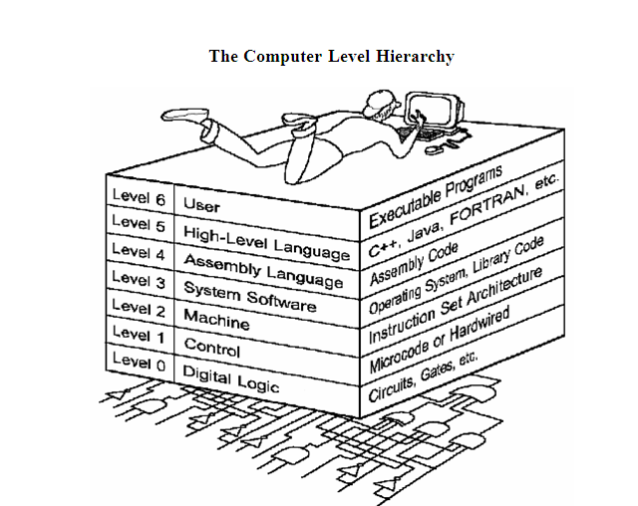

Slide 21
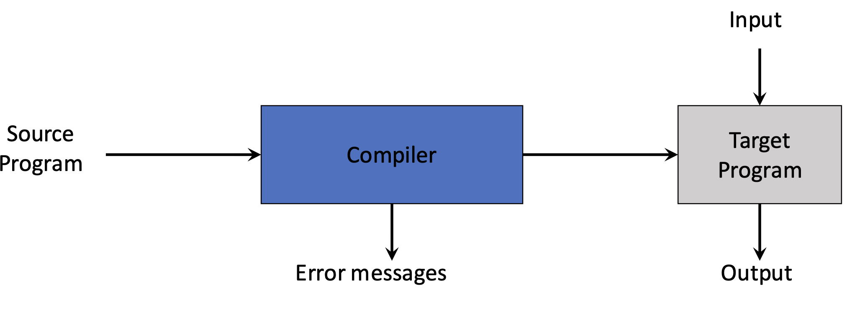
AOT Compilation
Examples?
C/C++, Rust, Go

Slide 22
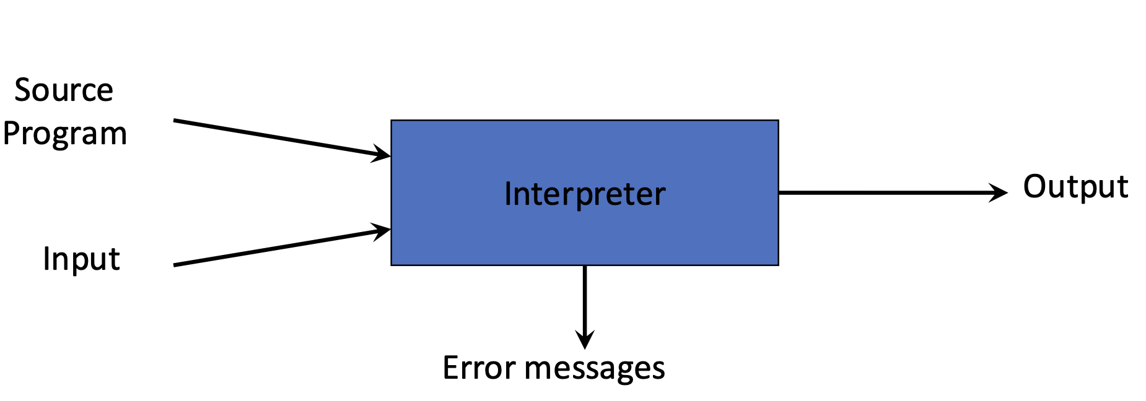
Pure Interpretation
Examples?
Python, Ruby, PHP (commonly hybrid, but can be pure as toys)

Slide 23
Pure Interpretation
The interpreter itself is usually compiled once to machine code (e.g., in C).
In a real interpreter :
There is a lexer (tokenizes source code)
A parser (builds a structure like an AST — abstract syntax tree)
An executor (walks the AST and performs operations)
Support for many types, operators, control flow, functions, I/O, etc.

Slide 24
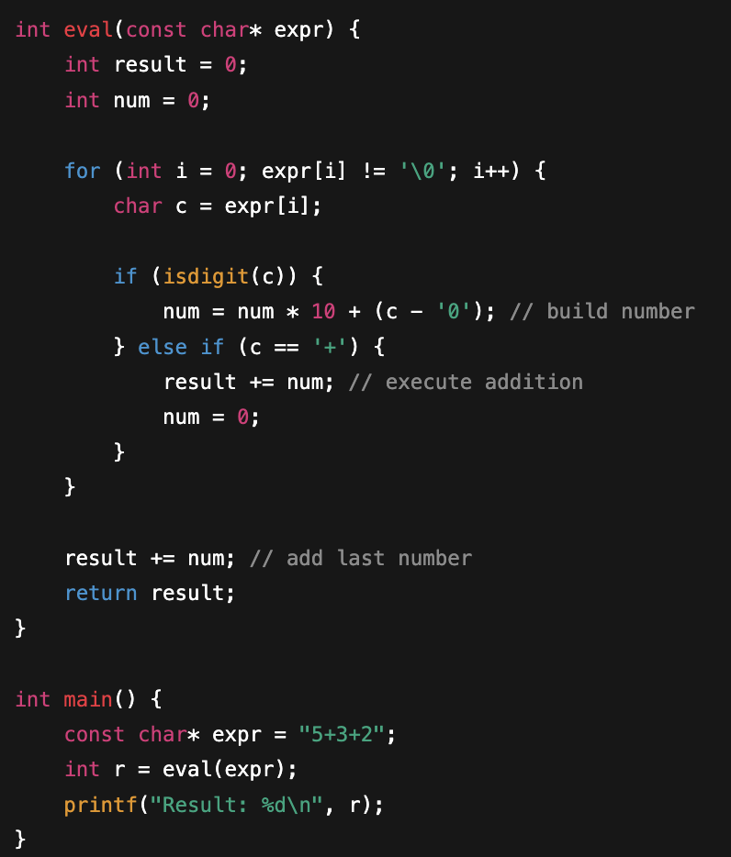
Pure Interpretation – a simple example

Slide 25
Compiler Advantages
Code often runs faster (can be >10x). Why?
avoiding the extra work of reading and executing each line one by one at runtime
Code is smaller
Less memory usage. Why?
interpreter must store the source code, parsing structures, and execution rules in memory
No re-interpretation
Can distribute executable files

Slide 26
Interpreter Advantages
Easier to write. Why?
Flexible syntax, e.g., Since the interpreter reads and executes code line by line at runtime, it can handle variables and structures dynamically, deciding types on the fly
Aids debugging (better diagnostics, why?)
interpreter runs code line by line and can immediately report exactly where an error occurs, including runtime values and context, instead of just failing after a full compilation
More flexibility
No build time

Slide 27
Hybrid Implementation Systems
Many modern language implementations use a combination of interpretation and compilation
Compromise between compilers and pure interpreters
Compiles to Intermediate Representation (IR) which is then interpreted
Faster than pure interpretation
Examples: Lisp, Perl (5), Python, Java

Slide 28
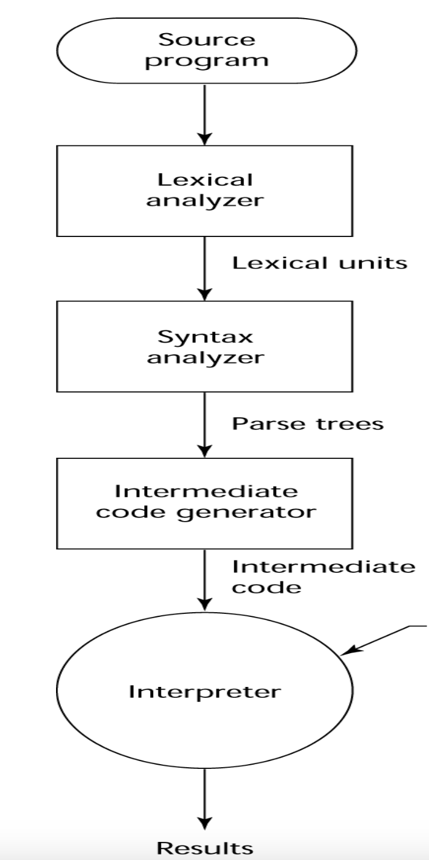
Hybrid Implementation Process
Intermediate Code Example: Java Bytecode
Input

Slide 29
Java HotSpot JVM
Java source program is first compiled to Java Bytecode
Java HotSpot JVM has two execution modes:
Interpreter: runs bytecode immediately, used for startup and for rarely called methods
JIT compiler: finds and compiles hot methods into optimized machine code

Slide 30
JIT Implementation Systems
Source code is compiled to an intermediate representation (IR)
At runtime, the VM JIT-compiles hot IR sections into native machine code
The generated machine code is cached and reused for future executions

Slide 31
.NET JIT Compilation
C# / VB.NET / F# → compiled to CIL (Common Intermediate Language) (IR)
CIL is an object-oriented assembly language
At runtime, the CLR JIT compiler translates CIL → native machine code
The machine code is executed directly by the CPU

Slide 32
